Slide 1

Fuzzy Entropy-Assisted Fuzzy-Rough
Feature Selection
Neil Mac Parthaláin
Richard Jensen
Qiang Shen
Advanced Reasoning Group
Department of Computer Science
The University of Wales,
Aberystwyth
CYMRU / WALES

Slide 2
Overview
Feature Selection and Rough & Fuzzy Sets
Fuzzy-Rough Feature Selection
Fuzzy Entropy
Fuzzy Entropy-Assisted Feature Selection
Results
Conclusion & Future work
Notes:
Start with an overview to the talk

Slide 3
Feature Selection
Feature Selection – select a subset of original features which provides the most useful information
Many advantages:
  Improvement in data presentation/visualisation
  Reduction in storage/measurement reqs.
  Others also: noise reduction, rule induction, prediction performance etc.
Notes:
1) May have many names

Slide 4
Rough Sets
Upper Approximation
Set X
Lower Approximation
Equivalence Class [X]_{b}
Image:
Fuzzy Rough Feature Significance For Fuzzy Decision Trees,
R. Jensen, Q. Shen Proceedings of UKCI’05 (2005)

Slide 5
Fuzzy-Rough Sets
Fuzzy-Rough set theory is an extension of rough set theory
Rough set theory unable to deal with real valued/noisy data. Membership is {0,1}
Fuzzy-Rough hybrid overcomes this allows membership of [0,1] thus allowing greater flexibility in handling real-world attributes

Slide 6

Fuzzy-Rough Sets
Fuzzy Equivalence Classes
Crisp Equivalence Classes

Slide 7
Fuzzy-Rough Feature Selection
Fuzzy Equivalence Classes central to Fuzzy-Rough approach
Decision and conditional values allowed to be fuzzy
Inclusion of a fuzzy similarity relation determines the extent to which two elements are similar

Slide 8
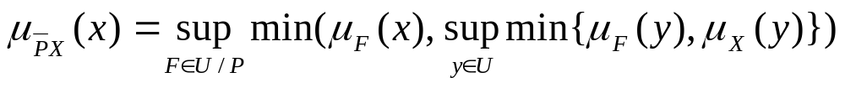
Fuzzy-Rough Feature Selection (2)
A fuzzy-rough set is defined by two fuzzy sets:
- Fuzzy Lower Approximation:
- Fuzzy Upper Approximation:
These are equivalent to the crisp (rough) counterparts in rough set theory

Slide 9
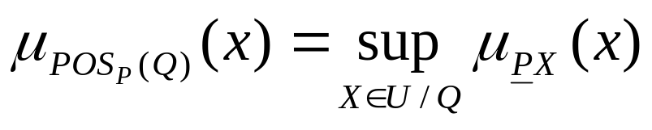
Fuzzy-Rough Feature Selection (3)
Fuzzy-Rough reduction achieved by utilising the fuzzy positive region:
Again, much in common with its crisp/rough relative
Feature Selection achieved by comparison of dependencies between conditional and decision attributes

Slide 10

Fuzzy-Rough Feature Selection (4)
Dependency function can be defined as:
Using the dependency function values subsets (reducts) are selected relative to their ‘goodness’

Slide 11
Fuzzy-Rough Feature Selection (5)
Existing fuzzy-rough algorithm relies on fuzzy dependencies to determine the ‘goodness’ of selected subsets
Uses only the data
Disadvantages:
Cannot guarantee minimal reducts
Greedy search approach is inadequate

Slide 12
Fuzzy Entropy-Assisted Fuzzy-Rough Feature Selection
What is Entropy?
Fuzzy Entropy-Assisted Fuzzy-Rough Feature Selection based on Information Entropy.
Approach described is Entropy assisted
Examines each subset and each preceding subset and compares them on the basis of dependency

Slide 13






Entropy-Assisted Fuzzy Rough Algorithm
FREQuickReduct(C,D)
C, the set of all conditional features;
D, the set of decision features.
(1) T ← {};
(2) do
(3) R ← T
(4)
(5)
(6) if
(7) T ←
(8) until
(9) return R
Entropy-based QUICKREDUCT algorithm:
Initially:
empty subset T, and
γ’_{PREV} (dependency) = 0
do
examine the entropy value of R
add a conditional feature n
if the entropy of (R  n) < that
of R, Let R = (R  n)
until
γ’_{PREV} begins to fall to a value
that is lower or equal to that
of the previous subset candidate

Slide 14
Fuzzy Entropy Assisted Fuzzy Rough Feature Selection (2)
Note that entropy value is not used as a termination criterion
Loop continues to evaluate in the described manner adding conditional features, until the dependency value of the current reduct candidate falls to a value lower than or equal to that of the previously evaluated reduct candidate

Slide 15
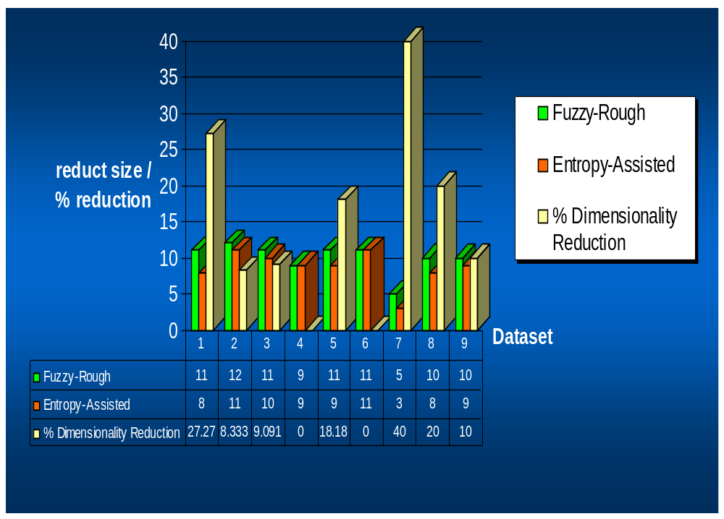
Experimentation & Results
Reduct size:
Entropy-based approach performs significantly better than Fuzzy-Rough method
Reduction in reduct size up to 40% recorded over Fuzzy-Rough method

Slide 16
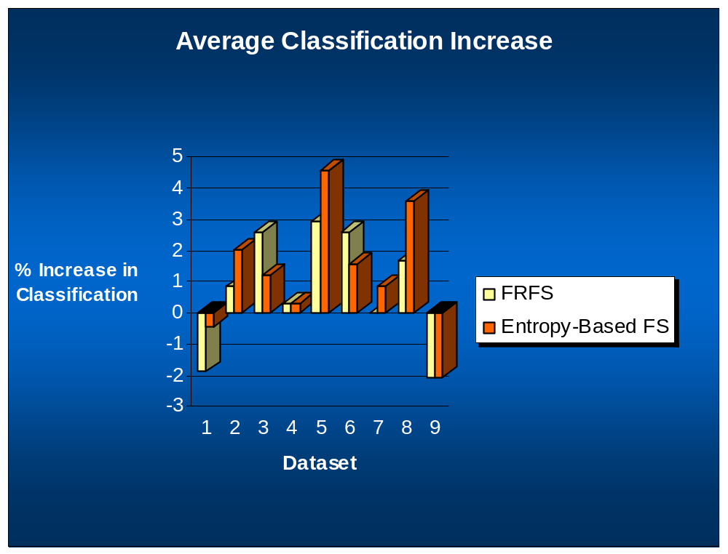
Experimentation & Results (2)
Classification:
    Small average increase over fuzzy-rough method.
    Fuzzy-Rough method also suffers from small decreases when compared to unreduced data
    Decreases insignificant when compared to overall increase in dimensionality reduction e.g – water2 dataset

Slide 17
Conclusion
Overall the entropy-assisted method offers improvements in performance in terms of:
Reduct size – up to 40%
Classification – small but significant considering corresponding level of dimensionality reduction

Slide 18
Conclusion
Future work:
    Optimisation of entropy-based QuickReduct algorithm
    Investigation of optimisation of fuzzifications
    Use of fuzzy classifiers
    Alternatives to greedy forward selection
    Investigation of Ant-Colony-Optimisation search strategy

